Slide 1
2022 volunteer trail maintainer orientation

Slide 2
WELCOME TO THE 2022 TRAIL MAINTAINER ORIENTATION!
“It’s easy to make a buck. It’s a lot tougher to make a difference.”
-Tom Brokaw
THE SHELTOWEE TRACE ASSOCIATION IS MEMBER SUPPORTED:
501c(3) non-profit formed to protect, preserve and promote the Sheltowee Trace National Recreational Trail as a significant national resource for the enjoyment of hikers, bikers and equestrians, and for the value that wild and scenic lands provide to all people.

Slide 3
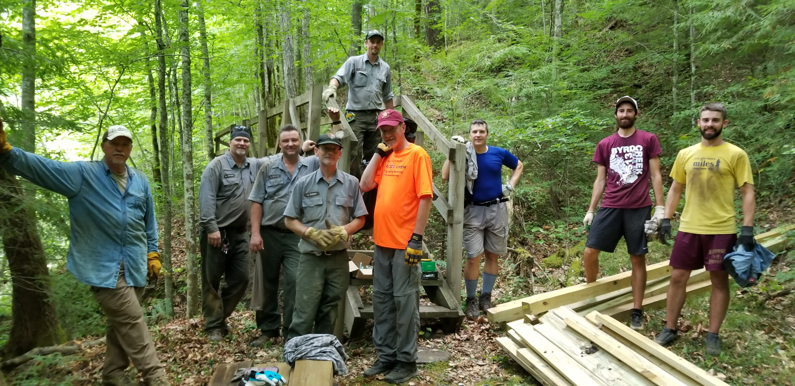
WHY?
Since our founding in 2009 our mission has been to:
Fill a need with the DBNF and BSF to assist in maintaining the Trace.
We work through:
organize trail maintenance crews,
individual volunteers,
the Adopt-A-Trail program.
Trail is currently 343 miles but with addition in Rugby, TN next year, we will be close to 354. We assist with maintaining all but the section in the Red River Gorge.

Slide 4
WHY THE NEED FOR AN ORIENTATION?
The STA is given the authority to work on trails through a Volunteer Agreement with the DBNF and as a Volunteer Group in the Big South Fork.
The agreement with the DBNF permits us to:
“train, equip, and organize volunteers to aid the Forest Service in trail maintenance as approved by the USFS along the STNRT and connecting side trails within the DBNF, excluding the section of the Sheltowee Trace that traverses the Red River Gorge. “

Slide 5
WHY THE NEED FOR AN ORIENTATION?
The agreement requires us to:
obtain parental consent for individuals under 18.
Inform volunteers that they may be subject to a background check and will be notified if a background check will be conducted.
hold training opportunities at least once a year.
provide oversight, coordination, and supervision as mutually determined necessary for a given project.

Slide 6
TRAIL MAINTAINER DISTINCTIONS
Volunteers are divided into two broad distinctions for the purpose of the agreement:
Trail maintenance volunteers – provide their time and effort in support of this agreement but who do not lead other volunteers or assume direct responsibility in the co-creation of provisions of this agreement.
Trail leader volunteer – volunteers who provide their time and effort in support of this agreement and who lead other volunteers or assume direct responsibility in the co-creation of the provisions of this agreement.

Slide 7
TRAIL CREW LEADERS
Trail crew leaders:
Will have greater interaction with Forest Service personnel
Will be required to partake in additional trainings commiserate to the program of work agreed to by the Forest Service and the STA to ensure the program is completed safely and effectively.
Training may include skills-based training and safety training as well as the Forest Service Code of Conduct and expectations regarding the maintenance of a safe, respectful work environment.

Slide 8
VOLUNTEER RESTRICTIONS
No volunteer (either maintenance or leader):
May use power tools or trail machines without proper safety training and certification.
Volunteers who wish to use such machinery in support of this agreement must seek guidance from the District Ranger on how to properly ensue all provisions of this agreement are met, prior to beginning work with said equipment.
Anyone using a chainsaw will be required to have a current FS chainsaw certification care as well as First Aid and CPR card.

Slide 9
TRAIL MAINTENANCE
Scope of Work – The STA will:
help design, build, maintain, and relocate trails,
install and maintain trail signs
maintain trailhead structures
all in accordance with the FSH 2309.18 Trail Management Handbook which can be downloaded from our website.

Slide 10
DEFINING TRAIL WORK
Trail work will include:
basic tread maintenance such as removing slough and berm,
re-establishing out slope for improved drainage,
reshaping, resetting or cleaning water bars and grade dips,
brushing and clearing,

Slide 11
DEFINING TRAIL WORK
Trail work will include:
tree blow-down removal,
debris removal,
rock removal, drainage system cleaning,
blaze maintenance
and trail tread reconstruction

Slide 12
DEFINING TRAIL WORK
Trail work will include:
tree blow-down removal,
debris removal,
rock removal, drainage system cleaning,
blaze maintenance
and trail tread reconstruction

Slide 13
DEFINING TRAIL WORK
Trail work other than routine brushing and clearing:
The STA will ensure that all trail work and the locations of all trail work will be proposed in a written plan of operations and approved by the district ranger.
Trail bridge repair will be approved on a case-by-case basis based on training and experience.
Corridor clearing will include pruning or removing small trees and rush within the corridor.

Slide 14
DEFINING TRAIL WORK – THE NO’S!
NO work will be performed outside the trail corridor without written permission from the Forest Service. This includes but is not limited to:
Rerouting the existing trail,
Realigning the existing trail, and moving the trail onto user created trail instead of the designated trail.
NO maintenance will occur on non-system routes, such as:
user-created trails
decommissioned roads unless explicitly agreed upon by the Forest Service and the STA.

Slide 15
DEFINING TRAIL WORK – THE NO’S!
The following activities are restricted and must be explicitly cleared by the District Ranger(s) before they can be completed:
any digging,
any work on water bars or other water control features,
any work in or adjacent to a waterway,
installation, removal and replacement of trail infrastructure such as stairs, bridges, retaining walls, and armoring,
obliteration and restoration of user-created trails, trai ljunctions, and features
obliteration and restoration of illegal or unsustainable user-created campsites

Slide 16
DEFINING TRAIL WORK – THE ALL’S
All trail maintenance and construction activities must meet FSH 6709.11 Health and Safety Code Handbook requirements. (See webpage for link)
Appropriate Personal Protective Equipment (PPE) as addressed in the Job Hazard Analyses (JHAs) will be used while performing trail work.
The STA and the District Rangers may provide tools and PPE as available.

Slide 17
SAFETY – TAILGATE SESSIONS – JHAs
Crew leaders will conduct, document and report a tailgate safety session prior to engaging in work on the approved reporting form. The tailgate safety session should cover:
the hazards of the work to be performed,
provisions of relevant JHAs,
an overview of expectations around maintain a respectful work environment,
working around the public,
representing the agency and our communities
and treating each other and visitors equally and respectfully.

Slide 18
SAFETY – TAILGATE SESSIONS – JHAs
Crew leaders and those working as individual volunteers and adopt-a-trail volunteers must:
submit the tailgate safety for to the STA trails coordinator, Denise Combs after each work event,
volunteers; either in a crew, individually working or part of the STA Adopt-A-Trail program will signify their awareness of hazards and mitigation measures by signing the Tailgate Safety Sign-In Sheet.

Slide 19
SAFETY – TAILGATE SESSIONS – JHAs
Crew leaders and volunteers are expected to review the following JHAs that apply to this agreement and are available for review on our webpage:
Trail Maintenance-General Safety
Use of Equipment & Machinery
Use of Weed and Brush Trimmer
Volunteer Chainsaw Operations ( if you are certified as a chainsaw operator)
Trash Collection

Slide 20
SAFETY- CHECK IN – CHECK OUT PROCEDURES
The Forest Service requires us to have a “check-in / check-out” procedure for STA volunteers; crew, individual, and or Adopt-A-Trail participants” to ensure we know who is working in the forest, when they started and that they returned safely.
Before entering the Forest including the Big South Fork, please text a simple message, your name, and something simple like “beginning work on the Boone at ……..” or “starting work with 3 of us at …….
When you finish a simple text that acknowledges everyone is back to your car and no issues or incidents will suffice.
Send to these three numbers so we know that your message reaches at least one of us:
606-308-0625 / 606-776-0812 / and 859-699-6801

Slide 21
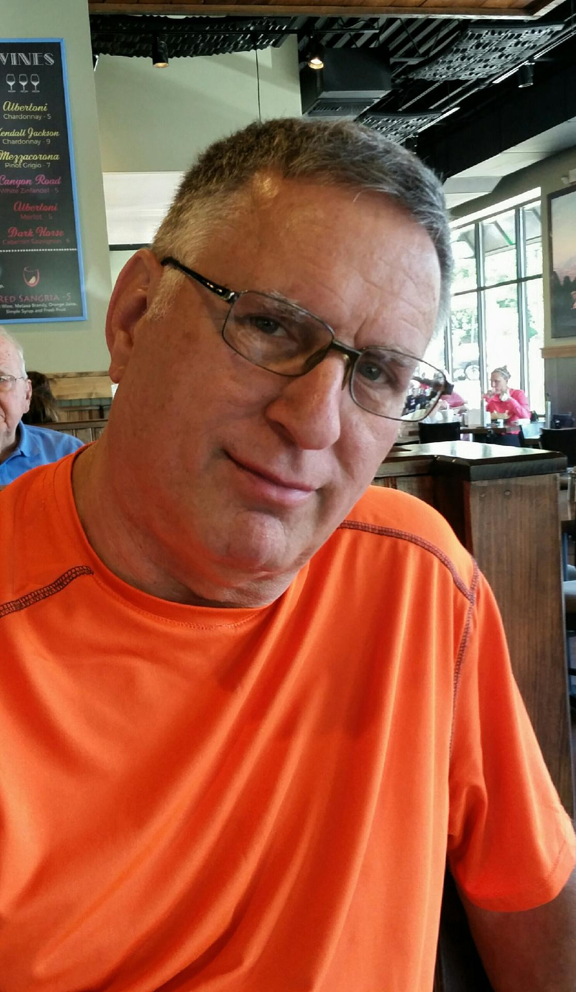
To Contact Us
Webpage: sheltoweetrace.org
Email: director@sheltoweetrace.org
Phone: 606 308 0625
Text Numbers for Check-In / Check-Out
Send to these three numbers so we know that your message reaches at least one of us:
606-308-0625 / 606-776-0812 / and 859-699-6801
Facebook: The Sheltowee Trace Association

Slide 22
Thank you for your willingness to help us preserve, protect and promote the Sheltowee Trace National Recreation Trail.

